Slide 1

SQL · POWER BI · DATA ANALYTICS
Pizza Runner
SQL Exploratory Data Analysis & Power BI Dashboard Project

Slide 2

Project Overview
An end-to-end data analytics workflow using a synthetic food delivery dataset. The objective: clean operational data with SQL, perform exploratory data analysis, and build an interactive Power BI dashboard.
The dataset mirrors real-world delivery operations — customer orders, runners, pizzas, recipes, and delivery activity.

Slide 3

TECH STACK
Tools & Technologies
PostgreSQL
Database engine for storing and querying delivery data
SQL & pgAdmin
Data cleaning, transformation, and exploratory analysis
Microsoft Power BI
Data modelling, relationships, and interactive dashboard development

Slide 4

Data Source & Import
Synthetic, Real-World Modeled
The dataset was created for learning and portfolio purposes but closely reflects real food delivery processes:
Order placement & cancellations
Delivery durations & distances
Order customisation (extras & exclusions)
Data was imported via Power BI's PostgreSQL connector, with table relationships verified in the data model.

Slide 5
DATA PREPARATION
Data Cleaning Process
Several quality issues were resolved in SQL before analysis:
1
2
Null Standardisation
Format Corrections
Empty strings and text 'null' converted to proper NULL values
Extra spaces and inconsistent comma formatting in extras/exclusions fixed
3
4
Regex Cleaning
Type Conversion
Non-numeric characters removed from distance and duration fields
Pickup times cast to proper timestamps; recipe toppings standardised

Slide 6
EDA: Key Metrics at a Glance
64
56
5
Total Pizzas
Unique Orders
Runners
Ordered across all transactions
Distinct customer orders placed
Active delivery runners in the dataset
SQL queries answered critical business questions — from delivery success rates per runner to pizza preferences by customer, maximum pizzas in a single order, and order customisation patterns.

Slide 7

EDA: Order Patterns & Preferences
🕐 Timing Insights
Order volume was analysed by hour of day and day of the week, revealing peak demand windows for operational planning.
🍕 Customisation Analysis
Orders were categorised by changes — extras, exclusions, or both — to understand customer behaviour and kitchen complexity.

Slide 8
DASHBOARD
Key Dashboard KPIs
Total Orders
Total Pizzas Ordered
Accepted Orders %
Avg Delivery Duration
Orders per Runner
Customisation %

Slide 9
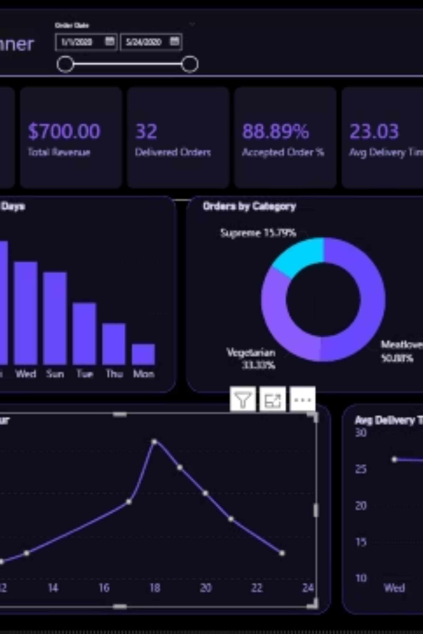
Power BI Visuals
Line Chart
Average delivery time by day of the week
Bar Charts
Orders per runner and pizza types delivered
Time Analysis
Orders broken down by hour and day
KPI Cards
Summarising key operational metrics at a glance

Slide 10

Outcome & Value
What This Project Demonstrates
Strong SQL data preparation skills
Real-world data modelling concepts
Translating business questions into actionable dashboards
The workflow mirrors typical analytics processes used in logistics and food delivery companies.

